Slide 1


Lightweight and Flexible Single-Path Congestion Control Coupling
Safiqul Islam
Networks and Distributed Systems Group
Department of Informatics
University of Oslo
Supervisors
Michael Welzl Univ of Oslo | Stein Gjessing Univ of Oslo
Dissertation Committee
Joerg Ott TU Munich | Colin Perkins Univ of Glasgow | Tor Skeie Simula Research Laboratory
NOMS’18 Conference
April 26, 2018

Slide 2
Motivation
Problem Statement
Notes:
The very first question, why are we doing this? Before delving into the details, let’s take a look at the thesis motivation

Slide 3
Problem Statement
Congestion control probes for the available capacity to reach a certain notion of fairness
Buffer
Capacity
More queue growth ➔ more delay and packet drops

Slide 4

Each Flow has its own Congestion Control (CC) module
Flow 1
CC
Flow 2
CC
Competition leads to:
CC
Flow 3
More queue growth
More packet drops
More delays
Fairness problems
CC
Flow n
Host
Notes:
when multiple flows, each having their own cc, share a bottleneck, they compete with each otheer… and such competition can create detrimental effect:

Slide 5
Would it be possible to solve these problems?
YES
Notes:
The question is
And the answer is :

Slide 6
Single
Congestion Controller
Flow 1
CC
Flow 2
CC
CC
Flow 3
CC
Flow n
Host
Notes:
This is possible to take the ccs out from the flows, and use a common congestion controller

Slide 7
Congestion Manager (CM)
Ensemble TCP (E-TCP)
Ensemble Flow Congestion Management (EFCM)
TCP FAST START
RFC2140
1997
1998
1999
1999
2005
Mostly designed having TCP in mind, except CM
Improves the TCP Initialization phase
Notes:
All the prior approaches tries to solve the problem, mostly considering TCP in mind! The first two improves only the startup behavior..
Others affect the overall connections…except CM, which is exceedingly hard to implement, does require revamping the entire congestion control, support TCP and UDP flows…

Slide 8
Single Congestion Controller
Flow 1
Flow 2
Flow 3
Flow n
This might work well for flows having the same tuple, but what happens when the bottleneck changes?
Host
Notes:
Getting back to the previous solution, might work for flows with the same 5 tuple, but what happens when the bottneck changes?

Slide 9
Single
Congestion Controller
Single
Congestion Controller
Flow 1
Flow 2
Add another CC?
Add another scheduler?
What about previous CC. state?
Flow 3
Flow n
Host
Notes:
Should we need another CC? add another scheduler? And what happens to the cc states?

Slide 10
Simple and Flexible
Ensure a common bottleneck
Make it Generic --- Apply to different CCs
Reduce overall delay and losses
#1
#2
#3
#4
Notes:
We should design a simple and flexible design…
We must ensure a common bottleneck so that the design can be applied..
Make it generic so that it can be applied to all the ccs, and reduce overall delay and losses, by eliminating the competition.

Slide 11
Simple and Flexible
Flow State Exchange (FSE)
#1
Flow State Exchange
Flow 1
CC
Flow 2
CC
CC
Flow 3
CC
Flow n
Notes:
What we propopse, is a simple and elegant solution, that doesn’t require revamping.. We propose a flow state exchange loosely couples the flows.

Slide 12
Two Variants
Simple and Flexible
Passive
Maintains the state of the ensemble and makes it available to only the flow requesting a new rate.
Less signaling
Minimal Changes
Homogeneous RTTs
Active
Actively initiates communication with all the flows.
#1
Notes:
There are two ways, our solution can be implemented, passive and active:
Passive: maintains the state of the ensemble, makes it only available to flow which requests a new rate..
And active where FSE actively initiates communication with all the flows.

Slide 13
Shared Bottlenecks
Ensure a common bottleneck
Managing flows with a common FSE: only across a common bottleneck
This was ignored in prior work (CM, E-TCP, EFCM)
But how to know?
Multiplexing (same 5-, actually 6-tuple)
Fits rtcweb (coupled-cc proposed in RMCAT) – but only for same source/destination hosts, and our own TCP-in-UDP (TiU) encapsulation.
Configuration (e.g. common wireless uplink)
Measurement
Never 100% reliable, but: different receivers possible!
Historically considered impractical, but recent work: David Hayes, Simone Ferlin-Oliveira, Michael Welzl: "Practical Passive Shared Bottleneck Detection Using Shape Summary Statistics, IEEE LCN 2014, 8-11 September 2014
#2
Notes:
As I mentioned earlier, coupling only makes sense for flows sharing a same bottleneck….. And this wasn’t considered in the prior work…
So the question is how to now?

Slide 14
#3 Apply to different CCs
Simple
Sophisticated
Loss-based
RAP
TFRC
TCP
Delay-based
LEDBAT
NADA
GCC
Notes:
We start with RAP, a simple AIMD like mechanism…representing a whole aimd class… and gradulation move to a more sophisticated one, like TFRC which is a loss based mechanism, but does update the rate based on an equation… and then finally to the most complicated ones, stateful mechanism such TCP……
And similarly, we started with the simple delay based mechanism like LEDBAT, and then gradually moved to NADA which is a bit more sophisticated that LEDBAT and then moved to GCC that is even more complicated.

Slide 15
Reduce overall loss and delay
#4
Notes:
And then here comes our last obective

Slide 16
Evaluations
Coupled Congestion Control for RTP Media
RAP and TFRC
WebRTC congestion controllers (NADA and GCC)
I-D – IETF RMCAT WG
SIGCOMM CCR’14, CSWS’14
NOMS’16
RFC editor Queue
TCP congestion control coupling
Novel ACK clock mechanism for initializing IW
RFC 2140bis
TCP-IN-UDP encapsulation
TCP CCC
Combining different CCC (LEDBAT and TCP)
ANRW’16
TCPM WG Draft
IRTF ICCRG Draft
GI’18
IMCEC’16
Notes:
Can we use the same technique? We started with the same basic idea…………. Keep a table of all the connections, calculate their share
Based on the priorities.. Update cwnd accordingly..

Slide 17
Evaluations
Coupled Congestion Control for RTP Media
RAP and TFRC
WebRTC congestion controllers (NADA and GCC)
I-D – IETF RMCAT WG
SIGCOMM CCR’14, CSWS’14
NOMS’16
RFC editor Queue
Notes:
We first show results for the RTP media..

Slide 18
RAP and TFRC
Every time the congestion controller of a flow determines a new sending rate, the flow calls UPDATE
FSE updates the sum of all rates, calculates the sending rates for all the flows and distributes them
Results were not good
Details are in the paper
for all flows i in FG do
FSE_R(i) = (P(i)*ΣCR)/ΣP
send FSE_R(i) to the flow I
end for

Slide 19
RAP and TFRC
Idea: reduce the rate on congestion as one flow.
No congestion: increase the aggregate by I/N where I is the increase factor.
Congestion: Proportionally reduce the rate to emulate the congestion response of one flow.
Avoid over-reacting: set a time (2RTTs) to react only once in the same loss event.

Slide 20
RAP
TFRC
Average Queue
Receiver makes assumptions about sending rate (expected length of loss interval) ➔ loss event ratio p calculation wrong ➔ sender too aggressive
Packet
Loss Ratio
Link Utilization
Notes:
The results was pretty good, but still the loss ratio of TFRC flow was slightly higher.. And the reason was due to TFRC loss event ratio calculation at the receiver side logic.. and since reciver making assumption of the sending rate.. Making the sender too aggressive…
So take way here: any receiver side cc must be taken into consideration…

Slide 21
Using priorities to “protect” the app-limited from the greedy flow (RAP)
High-priority (1) application limited flow #1 is hardly affected by a low-priority (0.2) flow #2 as long as there is enough capacity for flow 1
Notes:
We can even use priorities to protect app-limited flow.. And showed that high prirorty application limited flow is hardly affrected by a low priority greedy flow

Slide 22
Why passive version doesn’t always work: TCP example
Why??
TCP throughput is RTT dependent
Jains Fairness Index of 2 TCP Flows over a dumbbell topology
Notes:
You might be wondering, why we haven’t used the passive coupling? It doesn’t work well when ccs are rtt dependent..

Slide 23
NADA and GCC
RTT independent fairness
Rate update frequency
Fixed interval, RTT independent
-> Passive version works
Less signaling
Simple request-response server
Minimal changes
Can work as a stand-alone tool
Notes:
Interesting observation for NADA and GCC, and their fairness is either rate independent and update frequeny is fixed…
And we found that active version is superfluous here, and passive version works…..
And hence less signaling, even less minimal changes.. And can even use it as stand alone tool to play as a simple request-response server.

Slide 24
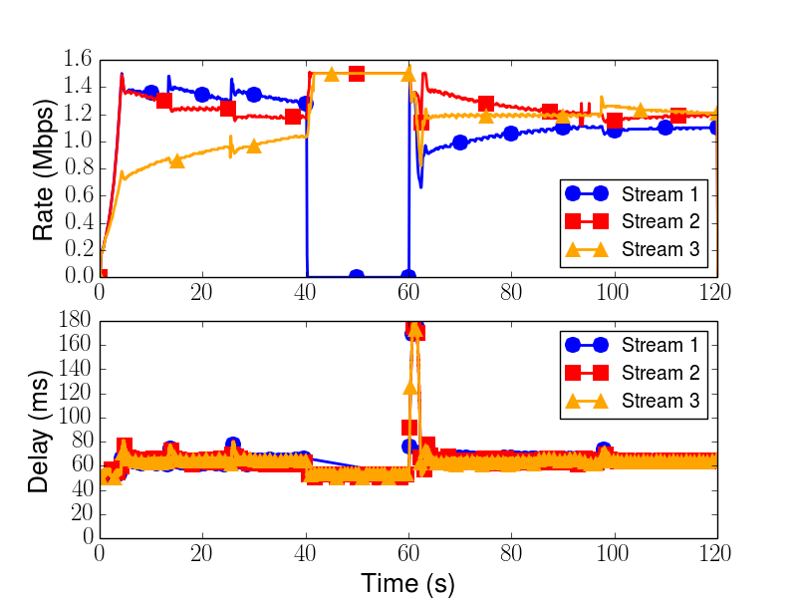
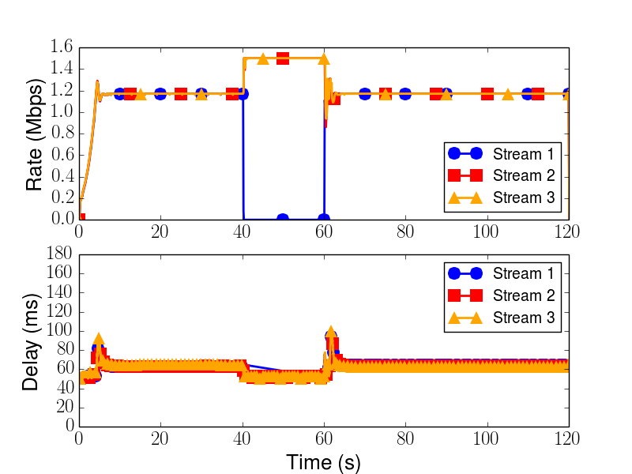
Media pause and resume (NADA)
Faster convergence, Fairness
Delay spike removed
Without FSE
With FSE
Notes:
There two continous and one intermittent flow, where steam one is paused at around 40 seconds and resumes again at around 60 seconds…. One way delay 50ms and Bottleneck capacity 3.5 Mbps
With the coupling on the right, it helps to faster convergance, and improves the delay spike suddenly introduced by a flow joining after a long time.

Slide 25
Delayed feedback test (GCC)
To show algorithm’s robustness against OS’s disturbance
Delay between stream 1 and the FSE is varied
Delay between stream 2 and the FSE is 0
Uniformly distributed
random delay, between
1 and 100
Fixed delay, 50ms
Fixed delay, 100ms
Notes:
To show the algorithm’s robustness against operating system’s disturbances, we also ran a delayed feedback test, where we varied the delay between stream 1 and the FSE and kept the delay 0 between the stream 2 and FSE..
And it can be seen that the FSE is robust against the disturbances, and hence it is possible to run FSE as a stand alone tool, where client can query as a simple request-response style signalling.

Slide 26
Evaluations
TCP congestion control coupling
Novel ACK clock mechanism for initializing IW
RFC 2140bis
TCP-IN-UDP encapsulation
TCP CCC
Combining different ccc (LEDBAT and TCP)
ANRW’16
TCPM WG Draft
ICCRG Draft
GI’18
IMCEC’16
Notes:
However, it is not easy to couple the algorithm that are stateful, and hence requires a further deeper understanding of the algorithm..

Slide 27
ACK-clocking to avoid bursts
A flow joining with a large share from the aggregate can create bursts in the network
If not paced
Our approach:
Maintain the ack-clock of TCP
Using the ACKs of conn 1 to clock packet transmissions of connection 2 over the course of the first RTT when connection 2 joins
Similarly, we make use of the ACKs of connections 1 and 2 to clock packet transmissions of conn 3
Requires slightly more changes to the TCP code
Drive an RFC2140 update to reflect the current state of the art, caveats on sharing TCB and pacing.
Notes:
Problem is shown on the top picture where flow 2 joins at around 5 second creates a suddent bursts in the network, and flow flow joins after 6 seconds and creates bursts in the network….
Previous mechanisms used timer to solve this problems, which requires another dynamics to be maintained.. What we propose is simple:
Use the ack clock of the previous connection to clock out the packet transmission for connection 2 use connection 1, and for connection 3 use both connection 1 and 2….

Slide 28
FCT of a short flow competing with a long flow
Notes:
Another benefit which we think is best for the shorts flows is “Faster flow completion time..” with the FSE flow completes much faster without the ack-clock mechanisms.. And with the ack clock it’s even improved…

Slide 29
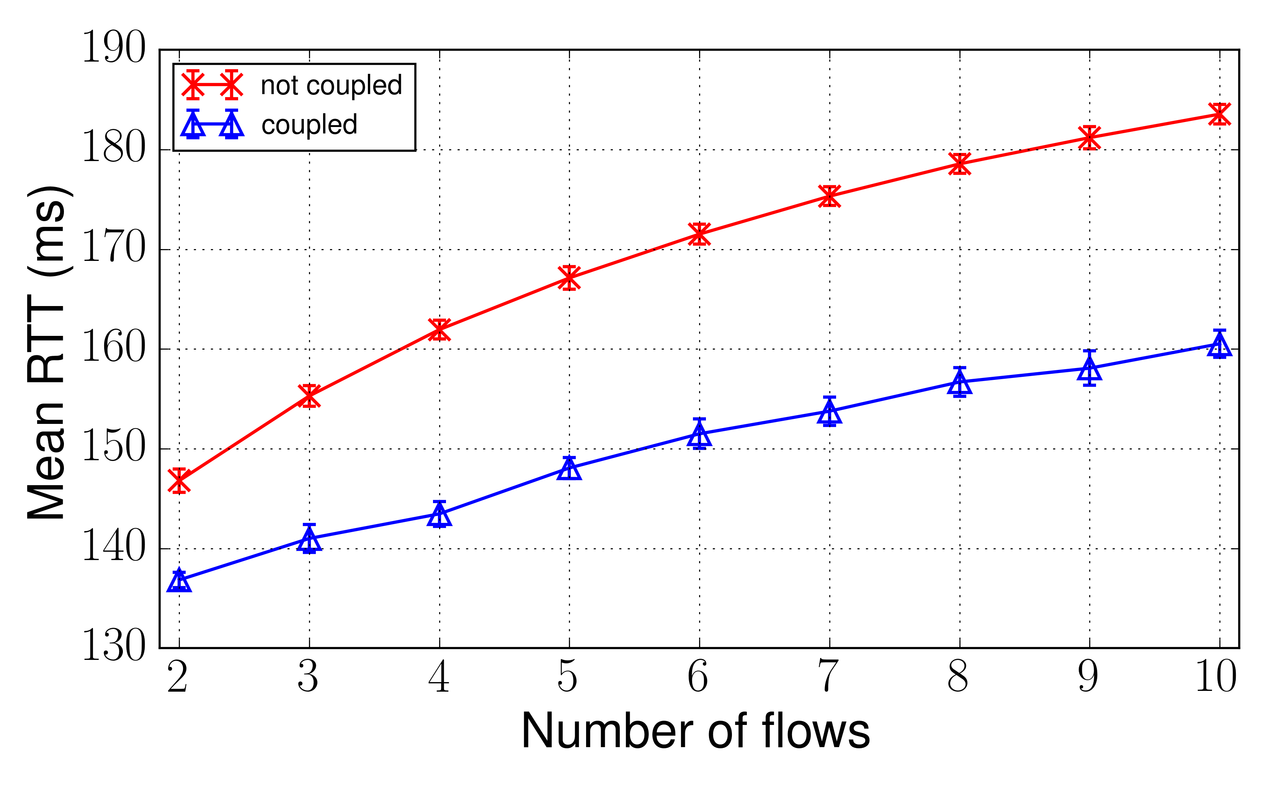
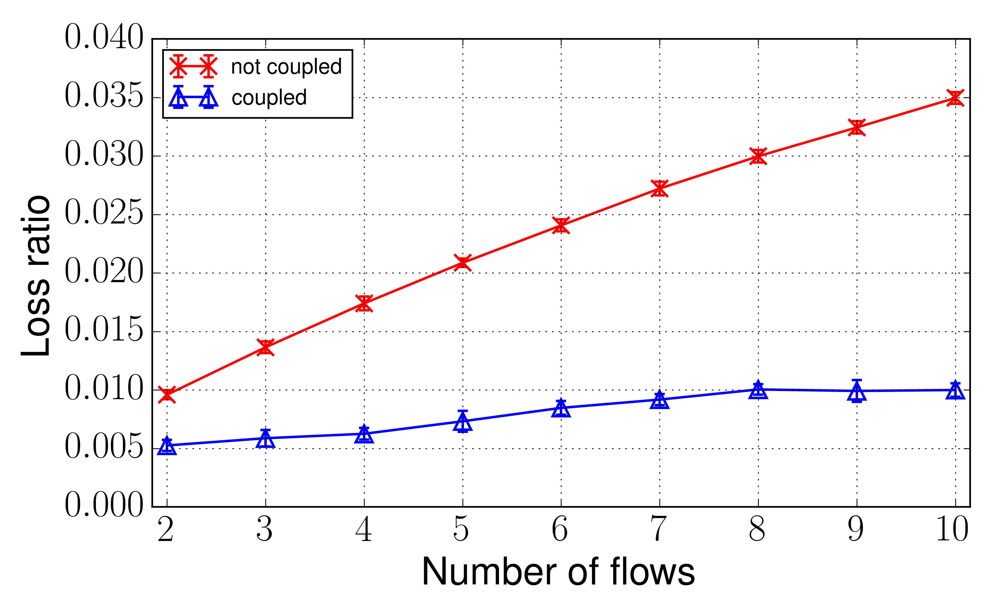
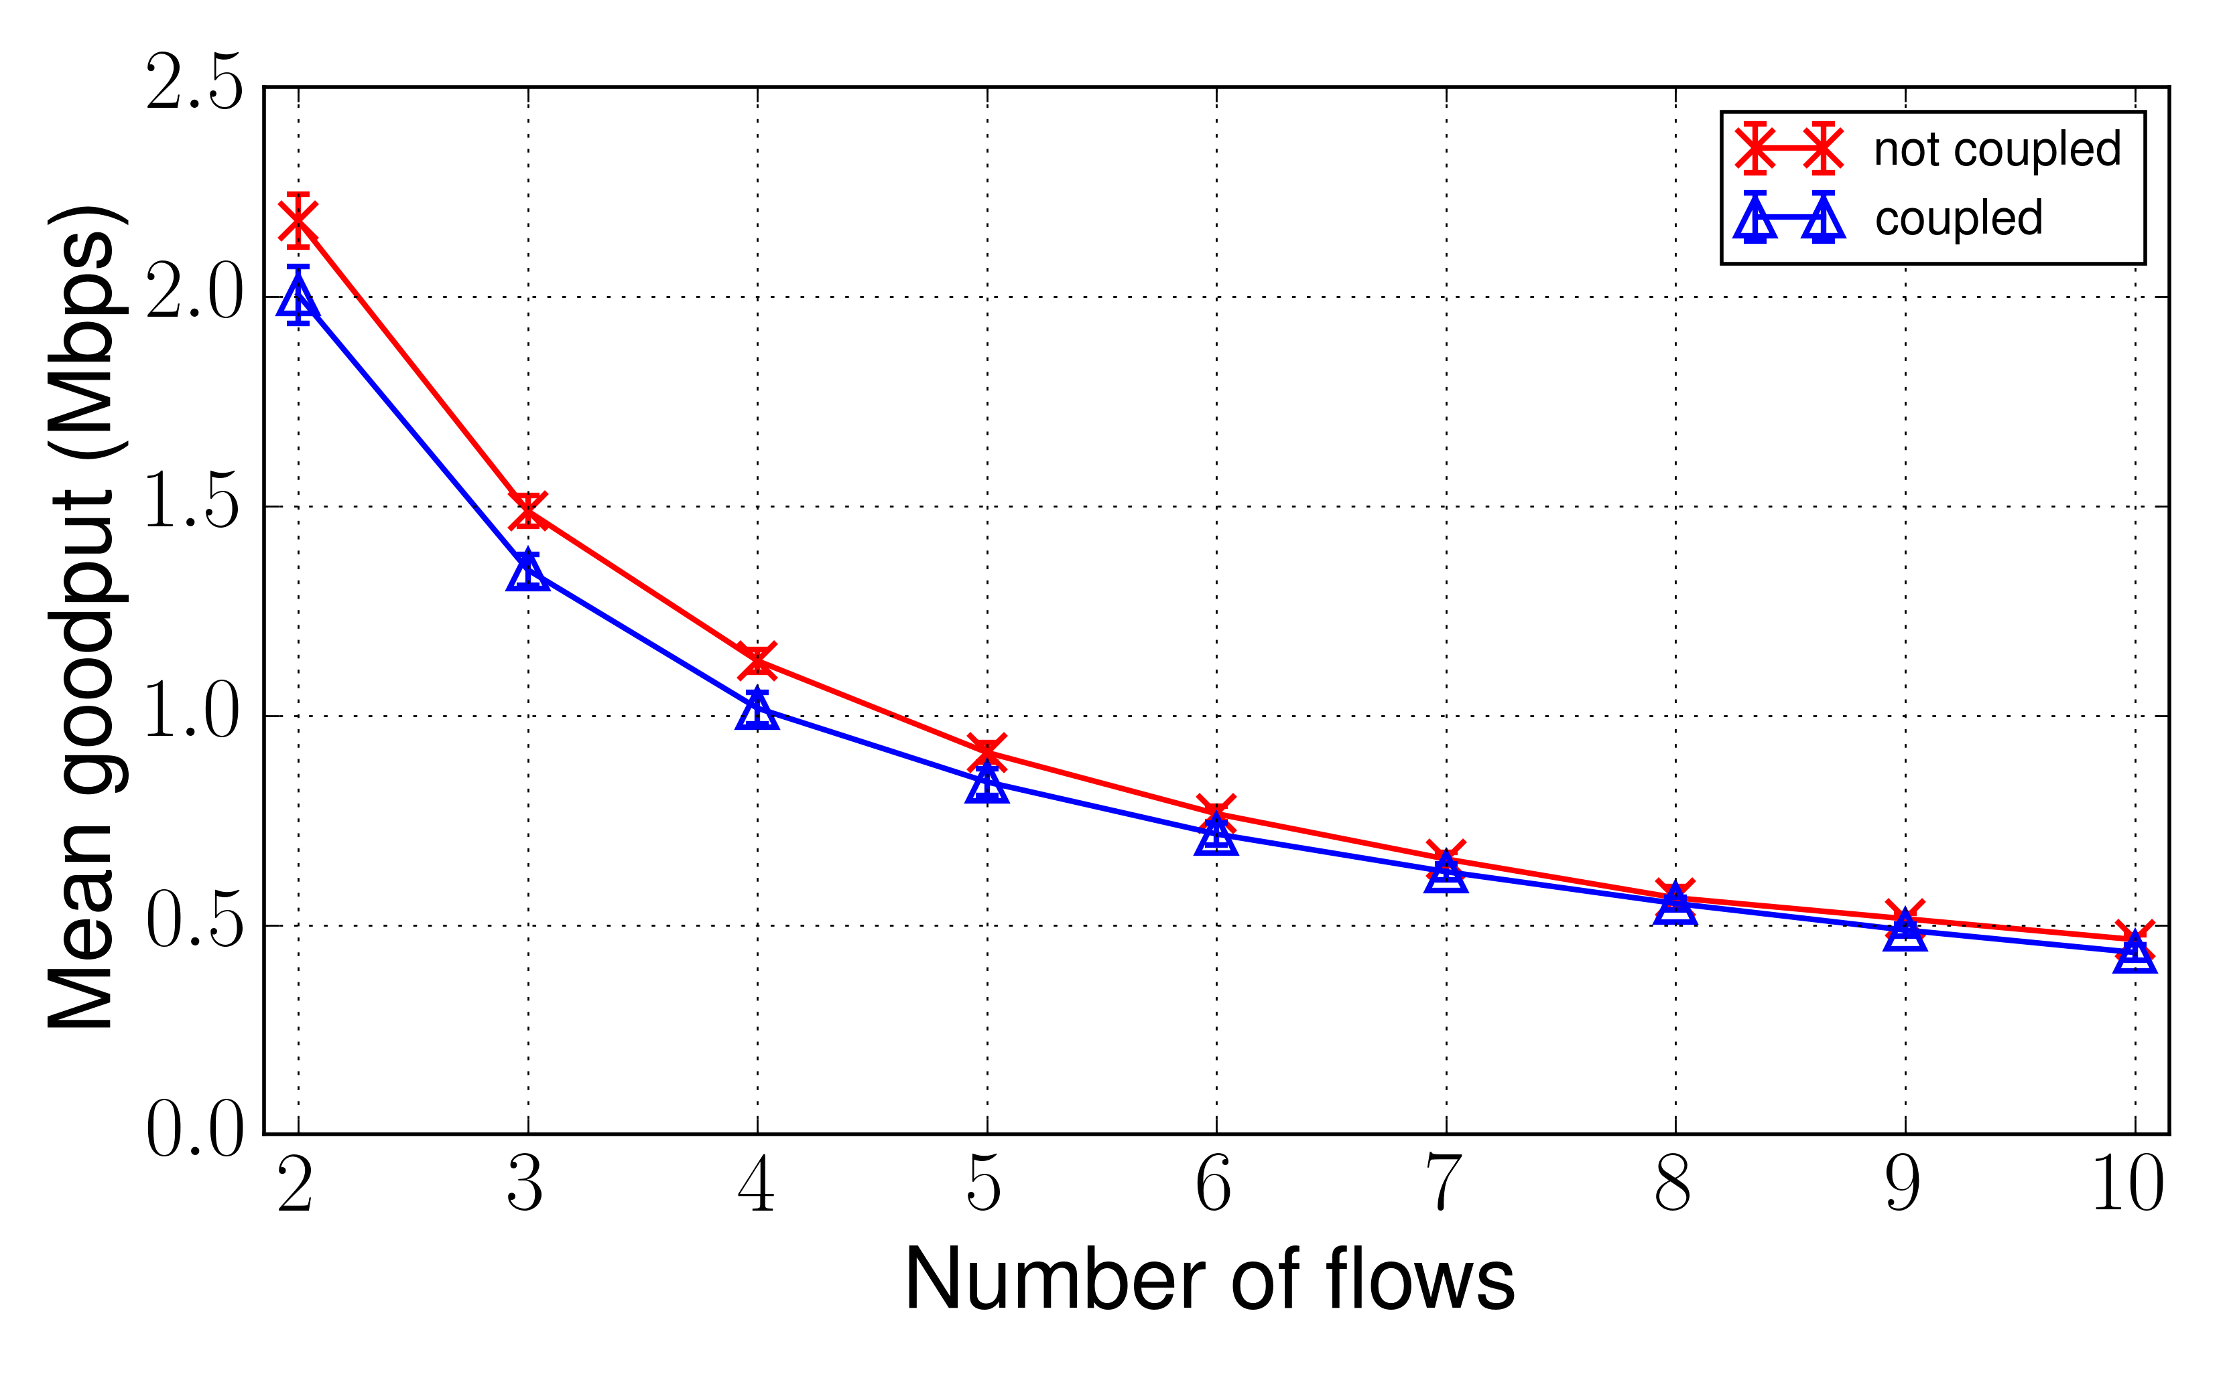
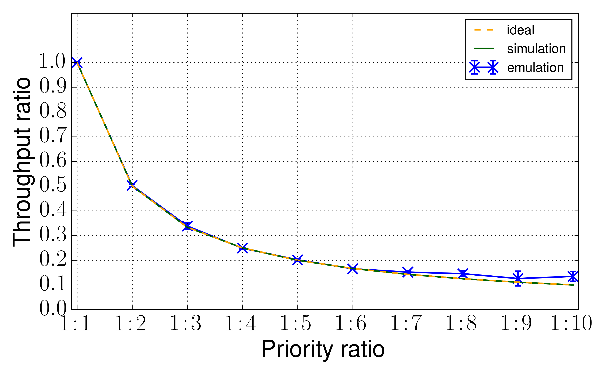
TCP-CCC (FreeBSD implementation)
Avg. RTT
Loss ratio
Prioritization
Avg. goodput
Notes:
Significantly reduces the delay, losses without significantly affecting the throughput…. And the last graph shows we can
Even assing based on the priorties of the flows.

Slide 30
Combining Heterogeneous Congestion Controllers
Without FSE
With FSE
This will allow us to combine WebRTC DATA Channel (SCTP) and Video (GCC) [Ongoing]

Slide 31
IETF Deployments
TCP FAST START
FSE, RFC ed-queue
TCP-CCC, ICCRG Draft
RFC2140bis
WG adopted draft, TCPM
RFC2140
CM
E-TCP
EFCM
1997
1998
1999
1999
2005
2015
2016
2017
Source code available at: www.bitbucket.org/safiqul
http://safiquli.at.ifi.uio.no/coupled-cc
Implementations: 1) FreeBSD 2) Chromium Browser 3) ns-2

Slide 32
Changing algorithm aggression | Reducing aggression can improve performance (Paper-1), but there are exceptions: it can violate the underlying CC algorithm’s assumption. This, in turn, can make the CC counteract on the imposed decision (paper-2 and draft-1).
RTT | Connections with homogeneous RTTs can use both active (paper 1) and passive coupling (paper-2, paper-4, paper-5). However, it is recommended to use an active version for connections with heterogeneous RTTs (paper 1).
Rate updates | Congestion control mechanisms that update their rates not as a function of RTTs but e.g. at a fixed interval can use simple passive version (paper 2).
Receiver- side Logic | If the CC decisions of a connection are influenced by receiver-side CC logic, this should be incorporated into the design of a coupled congestion control solution (paper 1).
Statefulness | It is recommended to incorporate states in a coupling solution when a congestion mechanism is stateful, e.g, TCP (paper 4,5 and draft 2). The design approaches for the stateless mechanisms are simpler (paper 1 and 2).
Ensured Common Bottleneck | Whenever it is enforced that connections take a common path, e.g., connections are multiplexed (e.g., WebRTC flows) or encapsulated (e.g., VPNs), a coupled congestion control mechanism can always be used (paper 1, 2,4,5 and draft 1,2).
Pacing | Giving a large share of the aggregate creates sudden bursts for window based congestion control, and therefore some form of pacing is required (paper 3). This can be achieved with a timer or by gradually handing over the share of the aggregate. Avoiding any increased burstiness due to CC coupling requires an algorithm to be active.
Combining Different CCs | Combinations of two different congestion control mechanisms can avoid bad interaction; for example, a loss-based controller can benefit from a delay-based controller which reacts on a congestion episode earlier (paper 4).

Slide 33
Thanks!

Slide 34
Q&A

Slide 35
Paper | Publication
1 | Safiqul Islam, Michael Welzl, Stein Gjessing, and Naeem Khademi, Coupled congestion control for RTP media, ACM Computer Communication Review, volume 44, Issue 4, October 2014
2 | Safiqul Islam, Michael Welzl, David Hayes, Stein Gjessing, Managing Real-Time Media Flows through a Flow State Exchange, IEEE NOMS 2016, Istanbul, Turkey, 25-29 April 2016
3 | Safiqul Islam, Michael Welzl, Start Me Up: Determining and Sharing TCP's Initial Congestion Window, ACM, IRTF, ISOC Applied Networking Research Workshop 2016 (ANRW 2016)
4 | OpenTCP: Combining Congestion Controls of Parallel TCP Connections, IEEE IMCEC 2016
5 | Safiqul Islam, Michael Welzl, Kristian Hiorth, David Hayes, Greville Armitage, Stein Gjessing, Single-Path TCP Congestion Control Coupling, IEEE INFOCOM GI 2018
IETF ID-1 | Safiqul Islam, Michael Welzl, Stein Gjessing, Coupled Congestion Control for RTP Media, Internet-draft draft-ietf-rmcat-coupled-cc-06, Mar 2017.
IETF ID-2 | Michael Welzl, Safiqul Islam , Kristian Hiorth, Jianjie You: " TCP-CCC: single-path TCP congestion control coupling", Internet-draft draft-welzl-tcp-ccc-0, Oct 2016.
IETF ID-3 | Joe Touch, Michael Welzl, Safiqul Islam, Jianjie You: TCP Control Block Interdependence, Internet-draft draft-touch-tcpm-2140bis-02, Jan 2017.

Slide 36
Backup Slides

Slide 37
Passive Coupling
Simple and Flexible
#1
Update_rate()
FSE
Flow 1
Store Information
New_Rate
Update_rate()
Calculate Rates
Flow 2
New_Rate
Update_rate()
Flow n
New_Rate
Notes:
Whenver flow 1’s cc calculates new rates, it updates it rates with the FSE (where FSE stores the information, and calculates rates), and then gets a new RATE from the FSE.. The same is true for Flow 2 .. And so on..

Slide 38
Active Coupling
Simple and Flexible
#1
FSE
Flow 1
Store Information
New_Rate
Update_rate()
Calculate Rates
Flow 2
New_Rate
Flow n
New_Rate
Notes:
In case of ACTIVE coupling, whenever a flow updates its rate with the FSE, FSE updates the rates of all the flows…

Slide 39
RAP and TFRC
RAP
TFRC
Average Queue
Length
Why?
Packet
Loss Ratio
Notes:
We started with a simple active algorithm.. Where we varied the number of RAP and TFRC flows and looked at the average queue length and packt losses, and it turned out the results for TFRC was a bit unsatisfactory… and why?

Slide 40
What’s going on? (simple algorithm)
With FSE
Without FSE
Queue drains more often without FSE
Should emulate the congestion response of one flow
FSE: 2 flows with rate X each; one flow halves its rate: 2X ➔ 1 ½X
When flows synchronize, both halve their rates on congestion, which halves the aggregate rate
We want that ! 2X ➔ 1X
Notes:
We zoomed in.. And looked at the queue growth over time, And figured out that queue drains more often than with the coupling.. This is due to the aggressiveness. When flows synchronize they both halve their rates on congesiton, and aggregate goes to 2X-1X, but however, in our case, it goes to 2->1.5X

Slide 41
CtrlTCP in DataCenter

Slide 42
LEDBAT

Slide 43
Evaluation – an application limited flow and one greedy flow (RAP)
FSE
Without FSE
FSE-controlled flows proportionally reduce the rate in case of congestion; without FSE, synchronization causes app-limited flow to over-react
Notes:
We also used an applicaton limited flow (video trace file…) and a greedy flow RAP and found tht withot the coupling the synchronization let the app-limited flow overreact, however, with FSE it’s smoother.

Slide 44
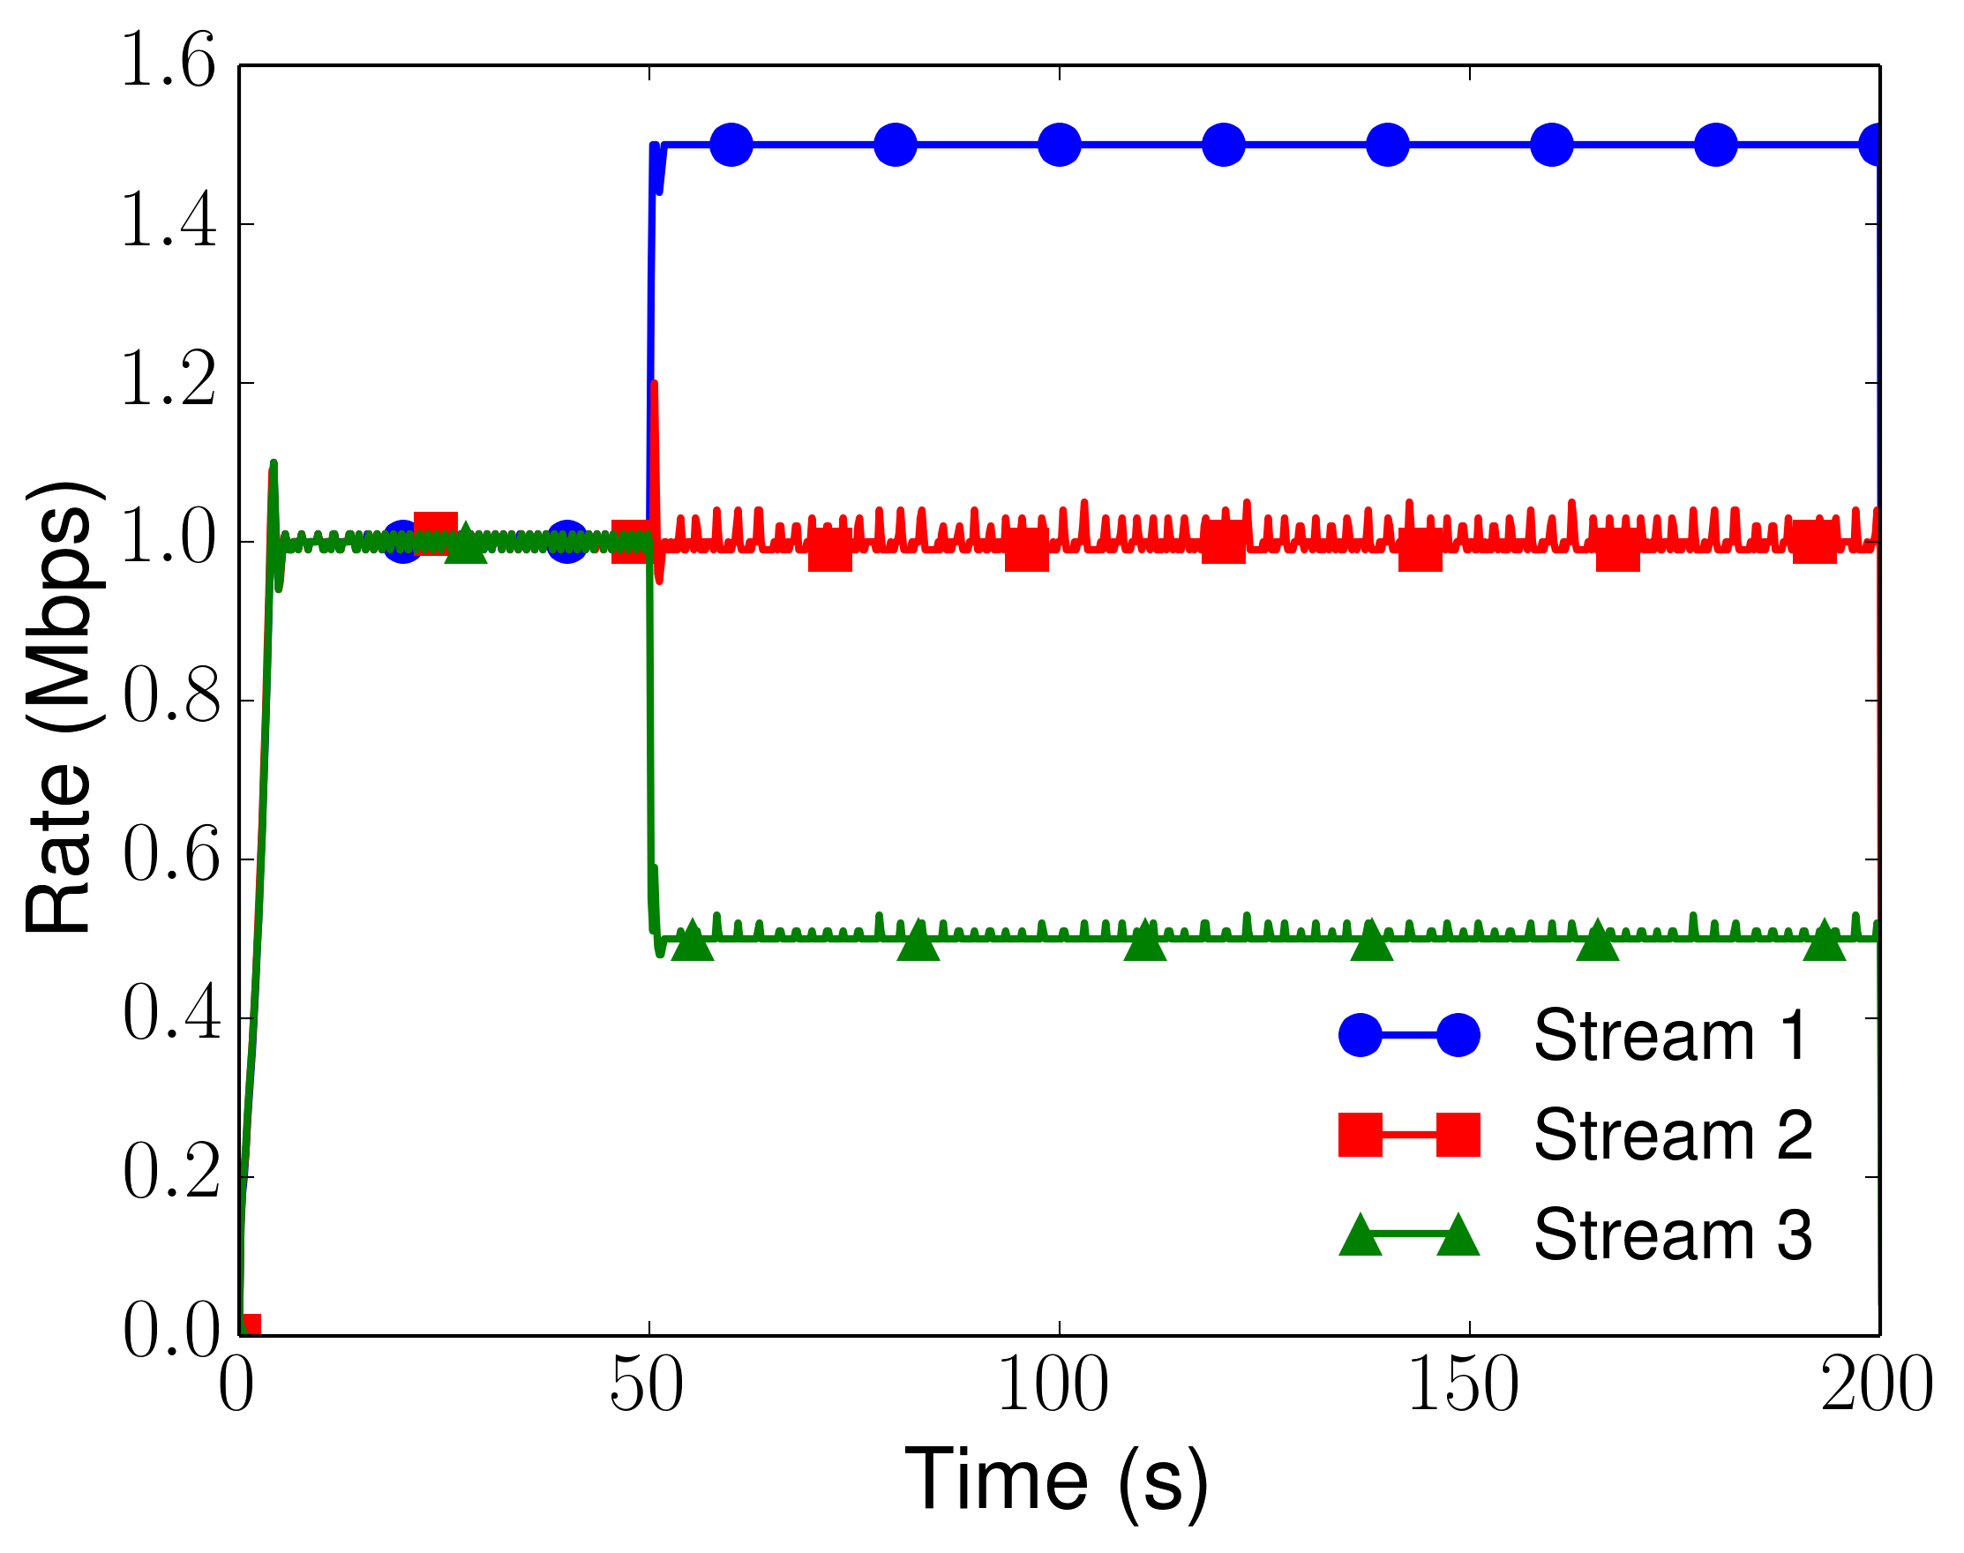
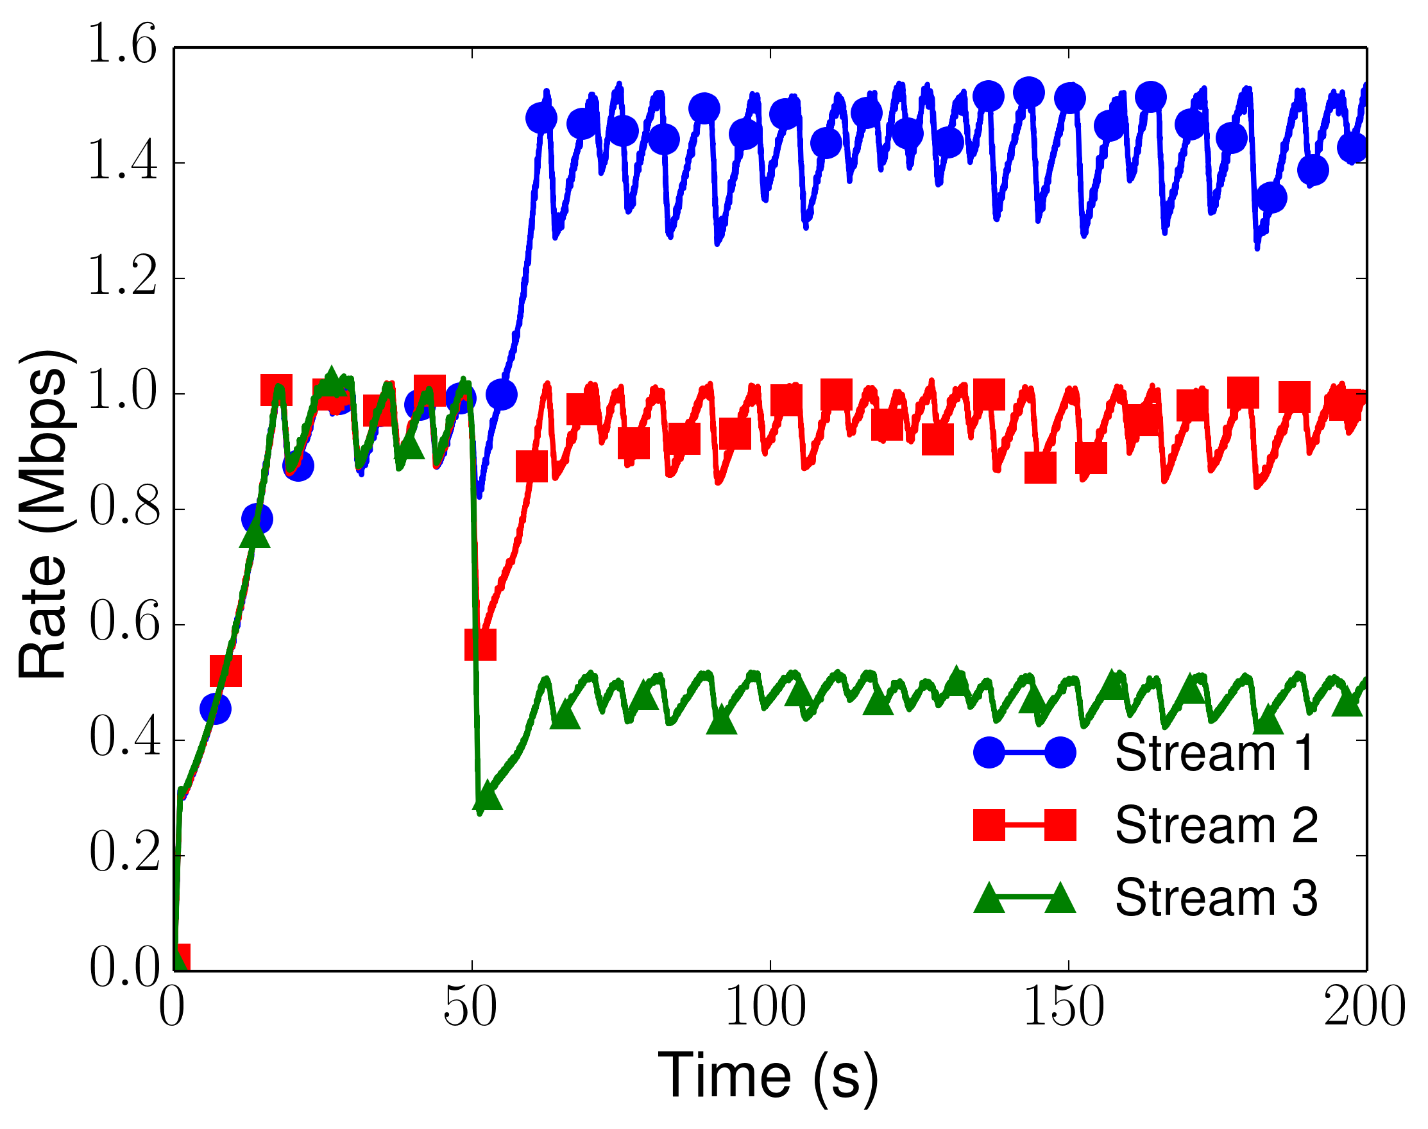
Prioritization test
NADA
GCC
One way base delay, 50ms, streams started with the same priorities.
Priorities are changed at 50 seconds.
Notes:
These are the results with the simple passive version, where we can assign rates based on their respective priorties. It can be seen from the plots that changing priorties on the fly at 50 seconds, we precisely allocate the rates among the flows…

Slide 45
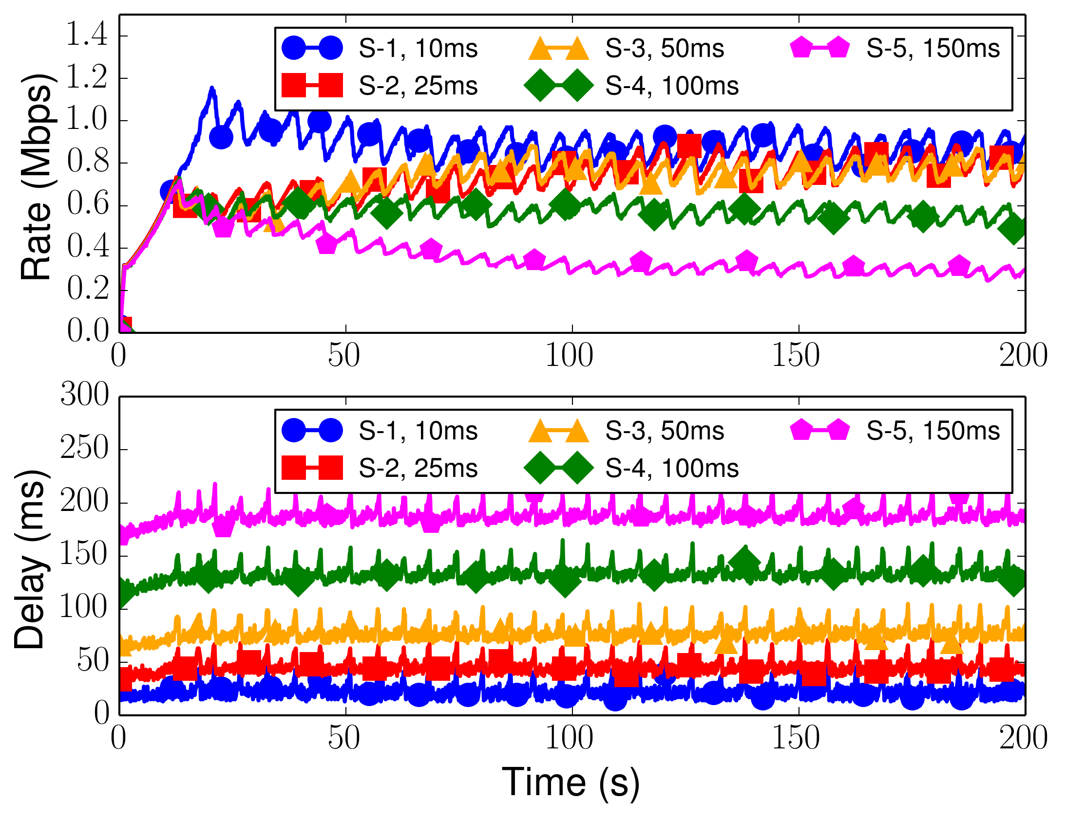
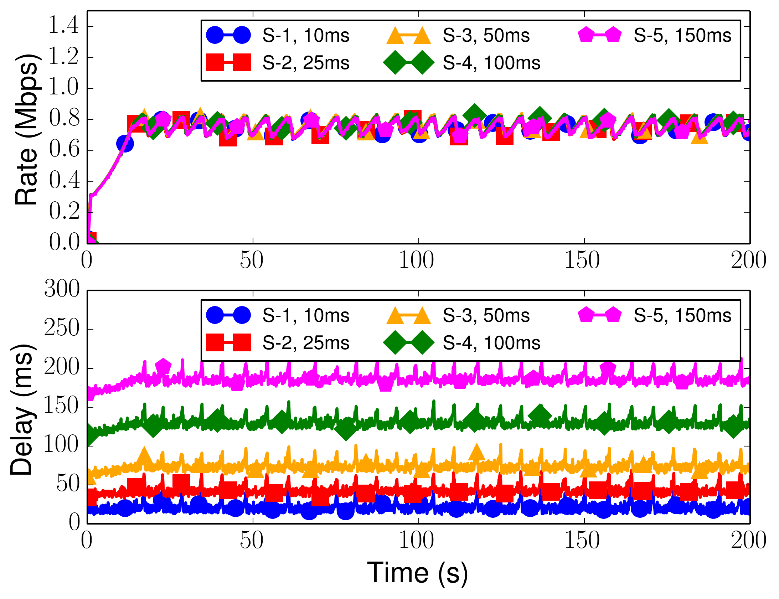
Round-trip time fairness – GCC streams
Faster convergence, Fairness
Without FSE
With FSE
One-way delays of s1, s2, s3, s4 and s5 are 10ms, 25ms, 50ms, 100ms, and 150ms respectively, and bottleneck capacity 4Mbps
Notes:
We use two of the pertinent RMCAT test cases.. To show the improve behavior with the Fse,.
1) Round trip time fairness where five flows with heterogeneous rtts and bottleneck capacity was 4 Mbps, FSE helps the GCC flows to converge quickly without incurring addition delay and losses.

Slide 46
Design
Basic idea similar to FSE in draft-ietf-rmcat-coupled-cc
To emulate one flow’s behavior (… but easy to tune)
Keep a table of all current connections c with their priorities P(c); calculate each connection’s share as P(c) / Σ(P) * Σ(cwnd); react when a connection updates its cwnd and use (cwnd(c) – previous cwnd(c)) to update Σ(cwnd)
Notes:
Can we use the same technique? We started with the same basic idea…………. Keep a table of all the connections, calculate their share
Based on the priorities.. Update cwnd accordingly..

Slide 47
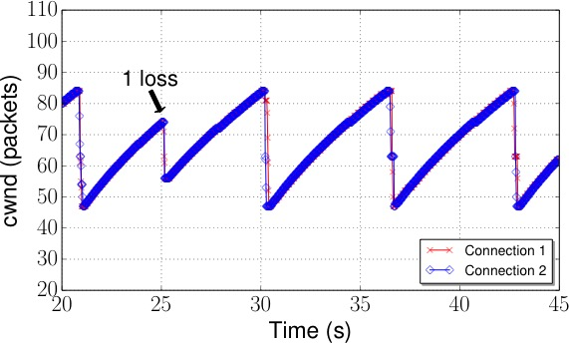
TCP states
Once in CA, Slow-Start(SS) shouldn’t happen as long as ACKs arrive on any flow ➔ only SS when all flows are in SS
Avoid multiple congestion reactions to one loss event:
TCP already has Fast Recovery (FR), use that instead
E-TCP
EFCM
Notes:
Base assumption behind timeout is: all was lost. Nothing makes it. This is not correct when ACKs arrive. When we consider the aggregate as one flow, it§s not true when ACKs arrive at ANY flow.
draft-ietf-rmcat-coupled-cc uses a timer

Slide 48
Basic TCP changes
The required changes to TCP:
This function call, to be executed at the beginning of a TCP connection ‘c’ : register(c, P, cwnd, sshtresh);
returns: cwnd, ssthresh, state
This function call, to be executed whenever TCP connection ‘c’ newly calculates cwnd:
update(c, cwnd, sshthresh, state);
returns: cwnd, ssthresh, state
This function call, to be executed whenever a TCP connection ‘c’ ends:
leave(c)
Notes:
These are the simple TCP changes we recommend, and invokes a register fucntion to the FSE whenever a flow joins, and returns the new rate..
Whenever there is a new cwnd calculation from the call, uses the update call to the FSE and get new rates in rate..
And leave function call to the FSE whenever a connetion ends.

